Slide 1


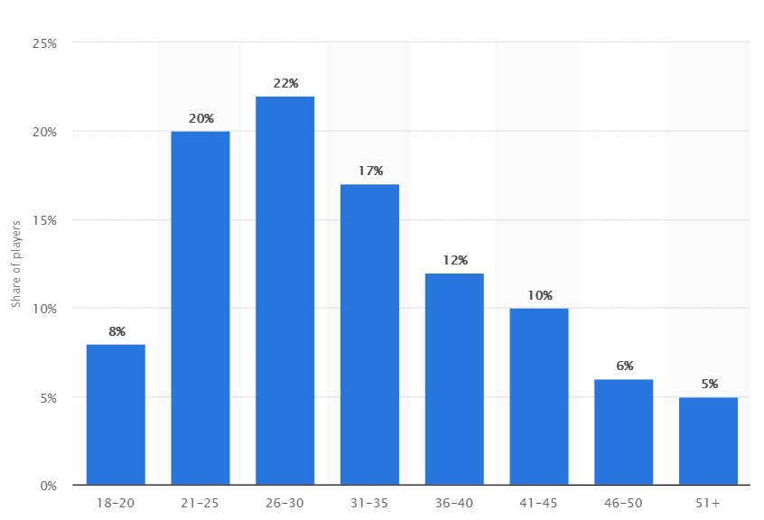

Synthetic Worlds:
Justifications for a Legal Framework
Elvin Gu <egu@andrew.cmu.edu>
Introduction
Bragg vs. Linden
The term synthetic world is a term popularized by economist Edward Castronova to refer to “crafted places inside computers that are designed to accommodate large numbers of people.” Synthetic worlds were initially popularized by game designers through text-based multi-user dungeons (MUDs) and are now more synonymous with massive multiplayer online role playing games (MMORPGs) like World of Warcraft.
Although this encompasses virtual reality, the primary focus will be on MMORPGs. They have been in the commercial scene for decades and are better study candidates.
Bragg had paid several thousands of dollars for parcels of virtual land in the world Second Life. However, his account was terminated as per the End User Licensing Agreement with no due process.
Bragg claimed that the contract was so lopsided and unfair in favor of Linden Lab and legally “unconscionable.”
Qiu Chengwe
Qiu Chengwe came to own a rare piece of virtual gear with a market value of a thousand U.S. dollars. He lent it to a friend who sold it to another play for cash and pocketed the money.
Qiu went to the police to report the theft, but the police did not thing the virtual item was legal property.
Reference: Statista.com
Objectives
Works Cited
The first objective is to bring seriousness to the issue and remove any prior bias against synthetic worlds. Secondly, there are two main issues that need to be tackled:
The lopsided relationship between host companies of synthetic worlds and their consumers
How to resolve disputes between players of synthetic worlds in a legal and ethical manner.
Castronova, E. (2007). Synthetic worlds: The business and culture of online games. Chicago: University of Chicago Press.
Lastowka, F. G. (2012). Virtual justice: The new laws of online worlds. New Haven, CT: Yale University Press.
Dougherty, Candidus. Bragg v. Linden: Virtual Property Rights Litigation. E-Commerce Law & Policy, Vol. 9, No. 7, July 2007.
Dibbell, J. (1999). My tiny life: Crime and passion in a virtual world. London: Fourth Estate.
Raicu, I (2013, August 1). Clicking Through to the Ethics of Social Media Terms of Service. Markkula Center for Applied Ethics at Santa Clara University.
Vrontis, D., & Thrassou, A. (2007). A new conceptual framework for business‐consumer relationships. Marketing Intelligence & Planning, 25(7), 789-806. doi:10.1108/02634500710834223
Conclusion
We propose the following policies:
EULAs must be reviewed by a third party before it has legal standing and must be made such that false advertising is not allowed.
Virtual crime needs to have legal ramifications, which means that host companies of synthetic worlds need to be able to cooperate with law enforcement.

